Slide 1
ELUCIDATING DRUG-DRUG INTERACTIONS UNDERLYING DRUG POLYPHARMACY PROFILES
UNIVERSITY OF COPENHAGEN
FACULTY OF HEALTH AND MEDICAL SCIENCES

Slide 2
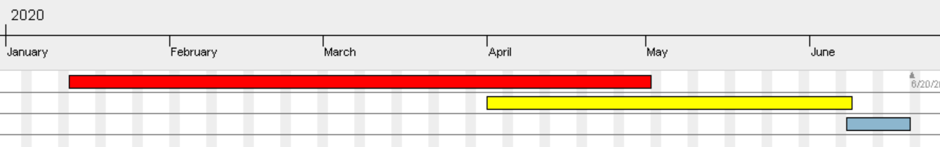
TIMELINE
Reading papers
Extracting and tidying data.
Part II
Part III
Phase 1; DDI Compendia
Phase 2; Computational analysis
Phase 3; TFG

Slide 3
The information we have until the moment
Databases analyzed
Databases pending
Would be nice
Drugbank
KEGG
Two sides
Crediblemeds
Interaktion_databasen
ONC-HIGH/NI
DDI Corpus 2011/2013
NLM corpus
PK corpus
HIV-INSITE
HIV interactions
HEP interactions
CANCER interactions
NDF-RT
Phaedra corpus
Flockchart table
SuperCYP
WebMD
Medline
Janusmed
Drugs.com
SemMedDB
PharmGKB
Additional resources
SIDER
Vigibase
Drug-gene database
Pubmed

Slide 4
PART I: Building a ddi compendia
Drugbank
Crediblemeds
NLM corpus
DDI compendia
PK corpus
ONC HIGH
KEGG
DDI corpus 2011
DDI corpus 2013
Two sides
ONC NI
Interaktion databasen

Slide 5
DDI features in a car-wash schema
 | Description | Intensity | Mechanism of action | Therapeutical effect | Side effect | Evidence level | Type of DDI | Dose of Drugs
DrugBank | X
KEGG | X | X | X
NDF-RT |  | X
TWOSIDES |  |  |  |  | X | X
Crediblemeds |  |  | X |  | X
ONC high |  |  |  |  |  | X
ONC non interrumptive |  |  |  |  |  | X
Interaktion databasen | X | X |  |  |  | X
HIV-INSITE | X |  | X | X |  |  |  | X
HIV | X | X |  |  |  | X
HEP | X | X |  |  |  | X
CANCER | X | X |  |  |  | X
DDI corpus 2011 | X
DDI corpus 2013 | X |  |  |  |  |  | X
NLM corpus | X
PK corpus | X
PHAEDRA corpus | X |  |  | X | X

Slide 6
Many databases lack of individual drug information
 | Pathways | Chemical group/class | Mechanism of action | Type of drug | Side effect | Other pharmacology aspects | Evidence level | CYP information
DrugBank | X | X | X | X | X | X
KEGG | X | X |  |  | X
NDF-RT |  | X |  |  | X |  | X
TWOSIDES |  |  |  |  | X |  | X
Crediblemeds |  |  | X |  | X | X
ONC high
ONC non interrumptive
Interaktion databasen |  | X |  |  |  | X |  | X
HIV-INSITE |  | X |  |  | X | X
HIV
HEP
CANCER
DDI corpus 2011
DDI corpus 2013
NLM corpus
PK corpus
PHAEDRA corpus |  |  |  |  | X | X

Slide 7
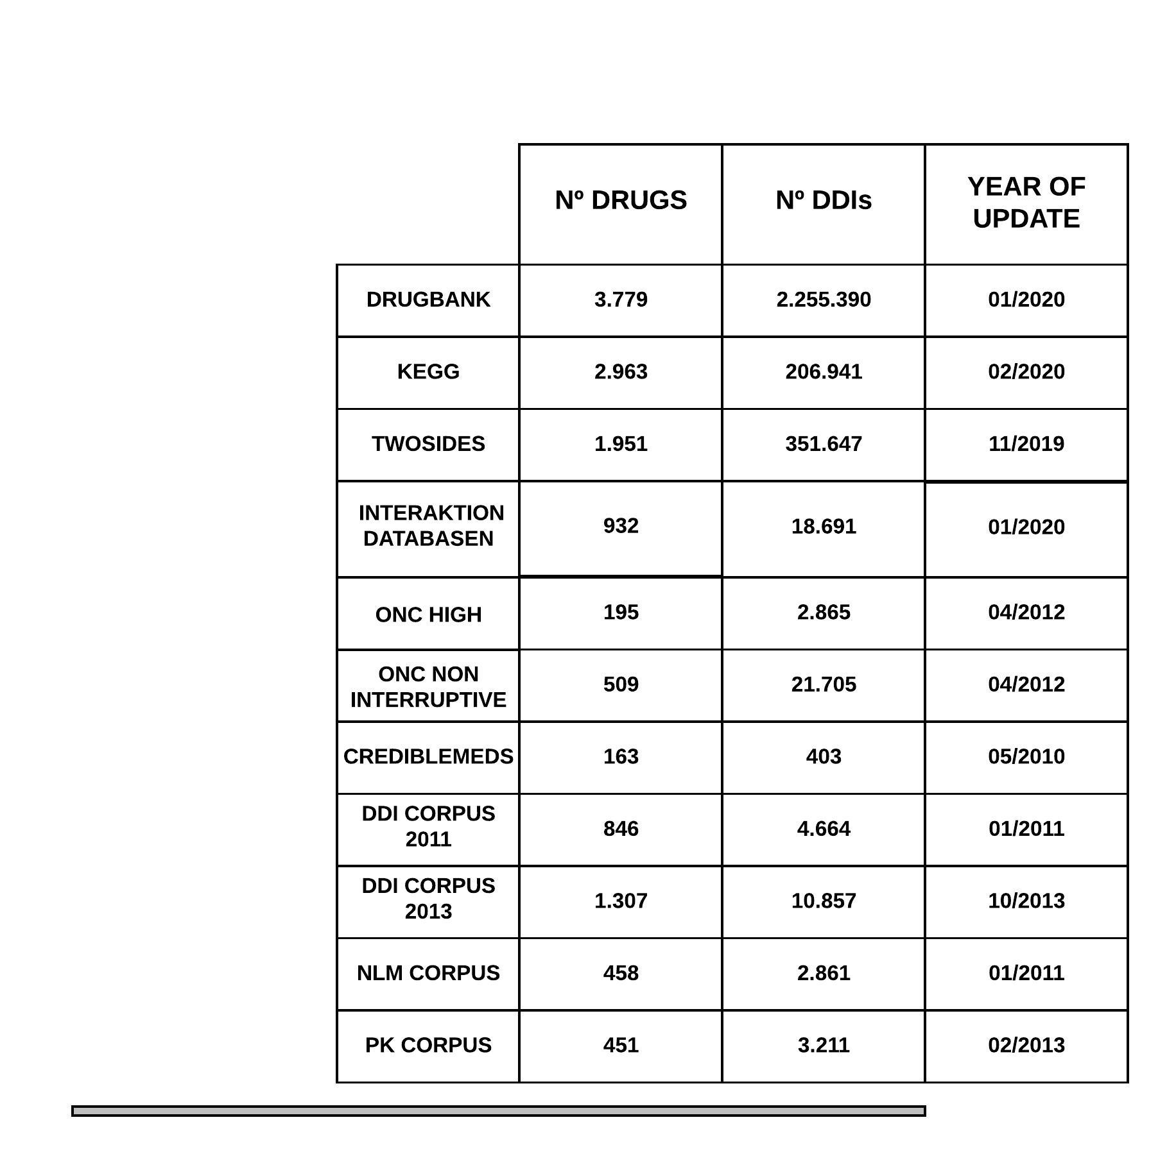
Data extracted into numbers
UNIQUE ELEMENTS
4.239
2.494.051

Slide 8
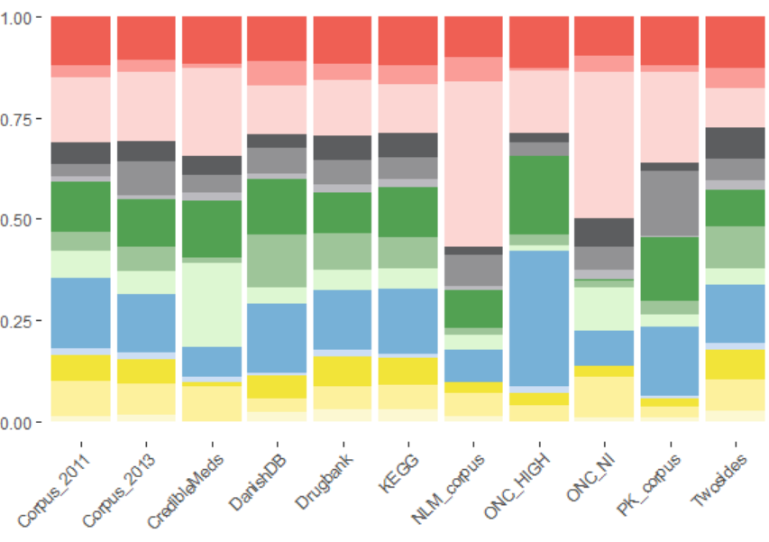
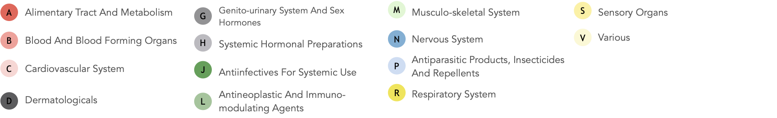
PART II: Comparison between sources
Interaction databases have different focus based on
Anatomical drug group

Slide 9
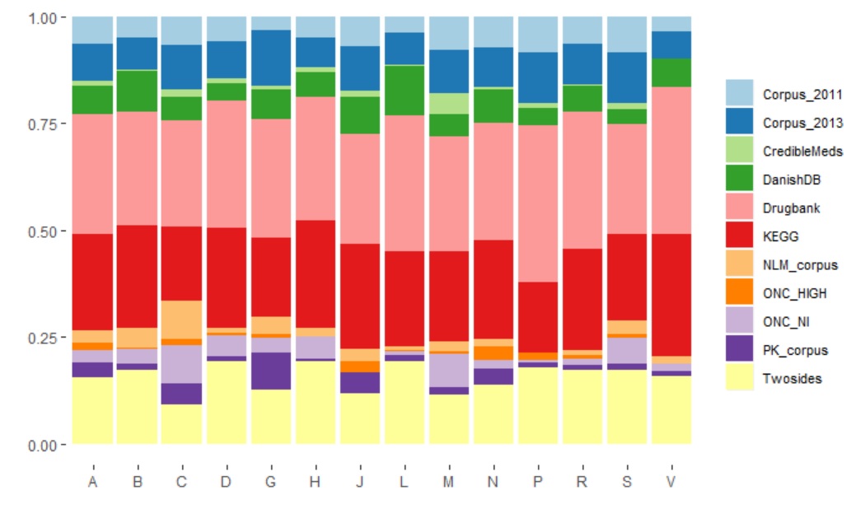
Decent similar percentage of coverage/Nº of drugs

Slide 10
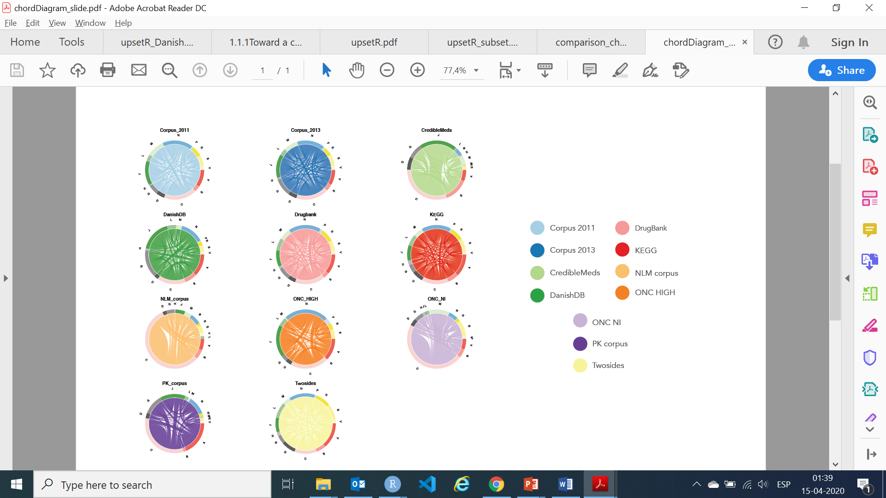

Visualizing flow diversity between the DDIs

Slide 11
Summary
Part I Building a compendia of DDIs information from public databases
Part II Comparison between the different data sources: scattered DDI knowledge
Part III Evaluation of the frequency of DDI in clinical practice using Electronic Health Records

Slide 12
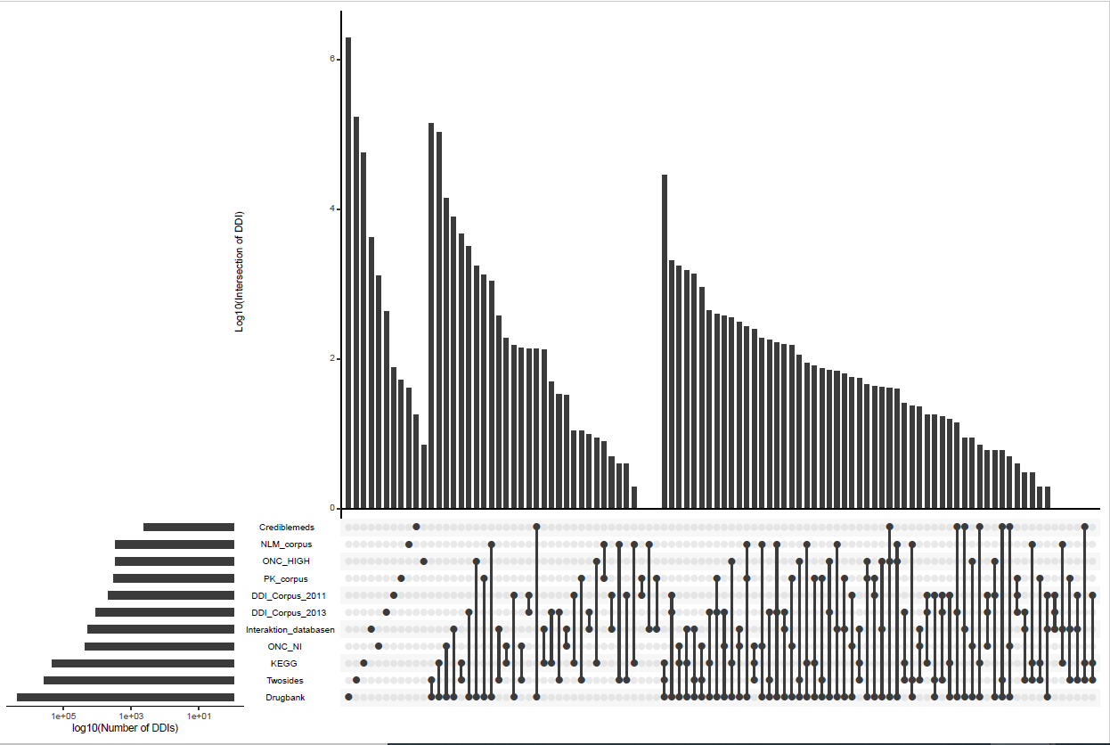
DDI overlapping; from a subset schema…

Slide 13
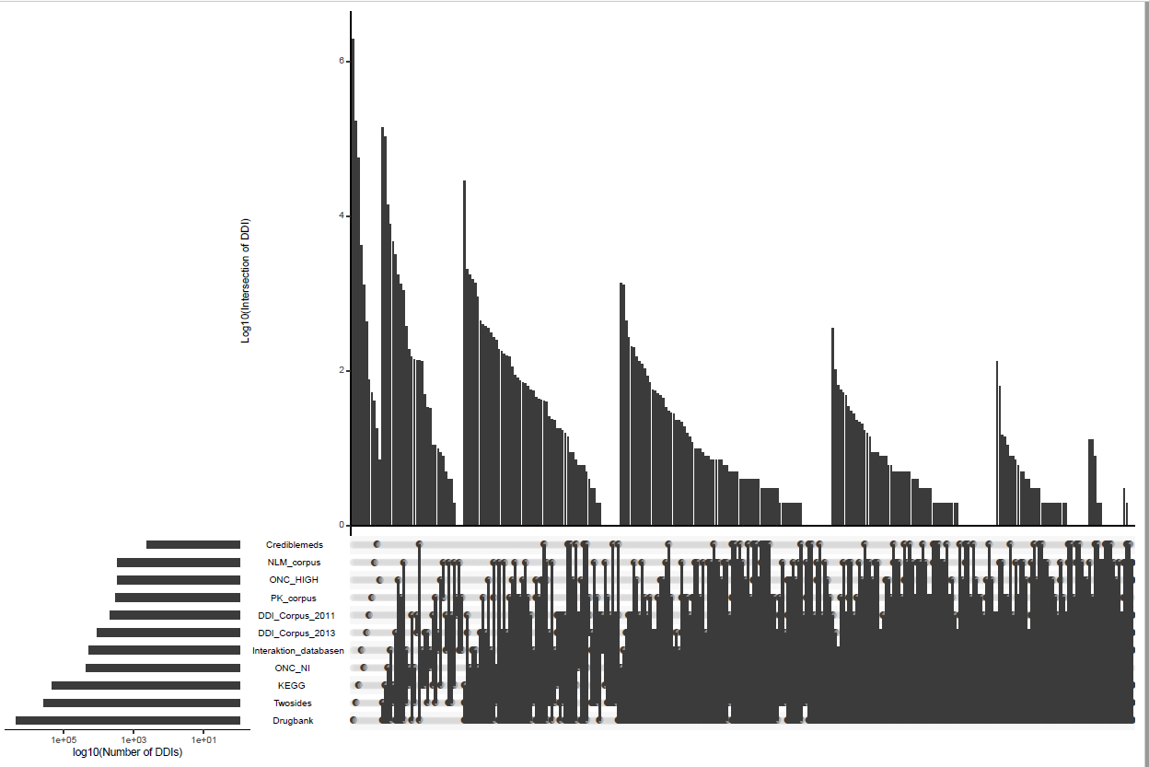
…to the whole overlapping distribution
To discuss coverage of interaktion databasen

Slide 14
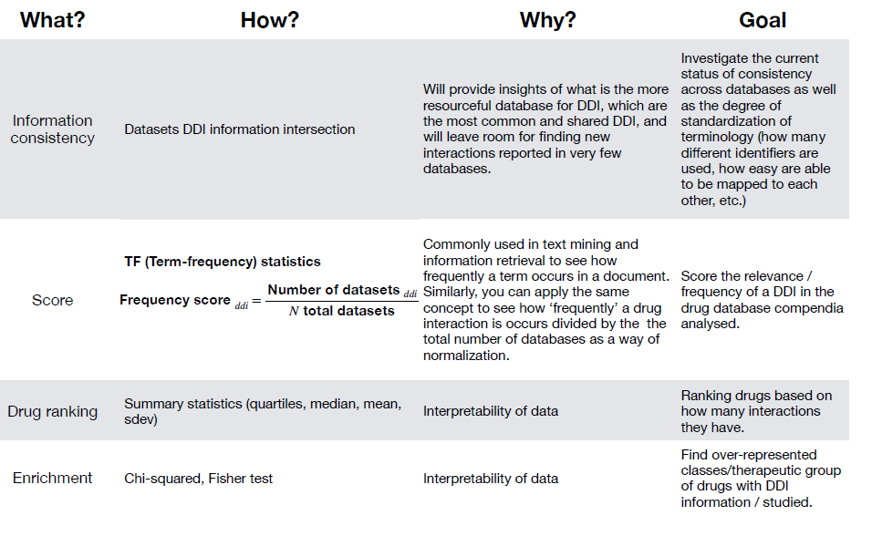
What’s next?

Slide 15
Part III: Evaluation of the frequency of DDI in clinical practice using Electronic Health Records

Slide 16
Detection of drug-drug interactions in clinical setting
Legend nodes:
Drug combinations from electronic health records
Drug interaction from publicly available databases
Legend edges:
Avoid combination
Combination needs monitoring
Combination is ok

Slide 17
INDEX

Slide 18
Inferring Interaktion databasen coverage
Goal : Reduce upsetR plot so to visualize between the intersections.
Do binary intersections with the smallest datasets.
Corpus 2011, Crediblemeds, ONC_HIGH, NLM corpus, PK corpus
Count the percentage obtained from these five databases in relation to the Interaktion databasen.
Corpus 2011 – Interaktion_databasen
PK corpus – Interaktion databasen
NLM corpus – Interaktion databasen
ONC HIGH – Interaktion databasen
Crediblemeds – Interaktion databasen
389
277
268
155
80
1.169/10.861
6,254 %
Reshape the upsetR plot with the remaining databases.

Slide 19
…to the whole overlapping distribution

Slide 20
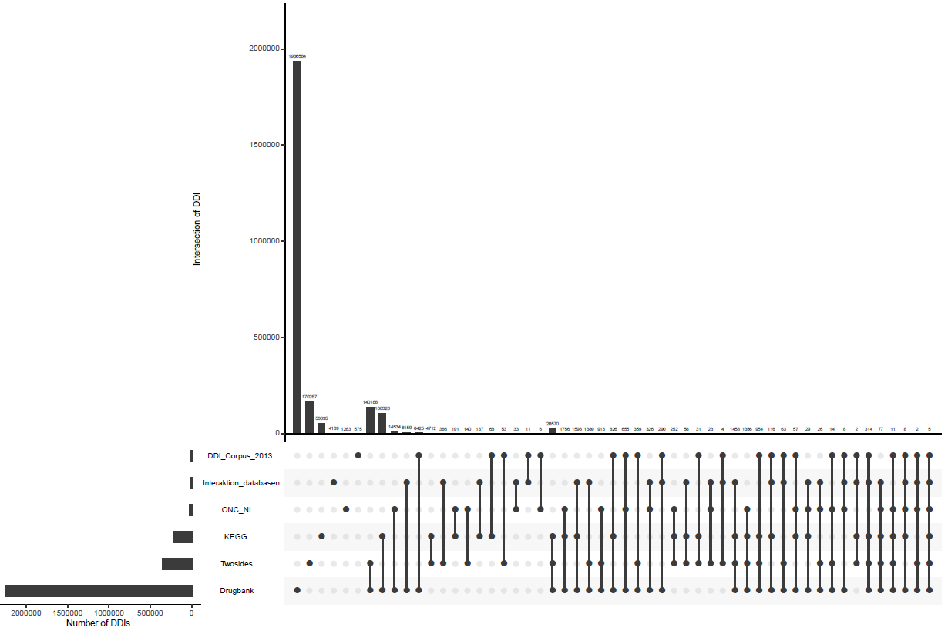

Slide 21
Once we count the quantities of the different intersections we have:
8.159 + 386 + 137 + 1.598 + … + 5.
14.511 DDIs covered by Drugbank, KEGG, Two sides, and DDI Corpus_2013. This supposes a 77.63 % of coverage.
Corpus 2011 – Interaktion_databasen
PK corpus – Interaktion databasen
NLM corpus – Interaktion databasen
ONC HIGH – Interaktion databasen
Crediblemeds – Interaktion databasen
389
277
268
155
80
(77,63%, 83,88%)
6,254 %

Slide 22
Drugbank
The DrugBank database is a unique bioinformatics and cheminformatics resource that combines detailed drug data with comprehensive drug target information.
Wishart DS, Feunang YD, Guo AC, Lo EJ, Marcu A, Grant JR, Sajed T, Johnson D, Li C, Sayeeda Z, Assempour N, Iynkkaran I, Liu Y, Maciejewski A, Gale N, Wilson A, Chin L, Cummings R, Le D, Pon A, Knox C, Wilson M. DrugBank 5.0: a major update to the DrugBank database for 2018. Nucleic Acids Res. 2017 Nov 8. doi: 10.1093/nar/gkx1037.

Slide 23
KEGG
Comprehensive drug information resource for approved drugs in Japan, USA and Europe, unified based on the chemical structure and/or the chemical component of active ingredients.
Each drug is associated with KEGG original annotations including therapeutic targets, drug metabolism, and other molecular interaction network information.
Kanehisa, M. and Goto, S.; KEGG: Kyoto Encyclopedia of Genes and Genomes. Nucleic Acids Res. 28, 27-30 (2000).

Slide 24
NDF-RT
The National Drug File - Reference Terminology (NDF-RT) is produced by the U.S. Department of Veterans Affairs, Veterans Health Administration (VHA). Until 2014
NDF-RT is used for modeling drug characteristics including ingredients, chemical structure, dose form, physiologic effect, mechanism of action, pharmacokinetics, and related diseases.
Kanehisa, M. and Goto, S.; KEGG: Kyoto Encyclopedia of Genes and Genomes. Nucleic Acids Res. 28, 27-30 (2000).

Slide 25
TWOSIDES
These data represent an update from the data released with the publication of [1], to include adverse events reported to the FDA through FAERS up to and including 2014.
Peculiarity that focuses of side effects of DDIs.
Tatonetti, Nicholas P., P. Ye Patrick, Roxana Daneshjou, and Russ B. Altman. "Data-driven prediction of drug effects and interactions." Science translational medicine 4, no. 125 (2012): 125ra31-125ra31. doi:10.1126/scitranslmed.3003377

Slide 26
CREDIBLEMEDS
Webpage focused on drugs and DDIs that induce arrhythmias and prolong QT interval.
Woosley RL, Heise CW , Gallo T, Tate J, Woosley D and Romero KA, www.CredibleMeds.org, QTdrugs List, [Accession Date], AZCERT, Inc. 1822 Innovation Park Dr., Oro Valley, AZ 85755

Slide 27
ONC HIGH/NI
Both databases have origin from a consensus and manual annotation between commercial drug companies like Lexicomp or Wolters Kluwer.
ONC HIGH is the compendia that covers the DDIs that should be avoided at all cost.
ONC NI covers the DDIs that should be monitored during its use.
S. Phansalkar, A.A. Desai, D. Bell, E. Yoshida, J. Doole, M. Czochanski, et al., High-priority drug–drug interactions for use in electronic health records, J.Am. Med. Inform. Assoc. JAMIA 19 (5) (2012) 735–743.
S. Phansalkar, H. van der Sijs, A.D. Tucker, A.A. Desai, D.S. Bell, J.M. Teich, et al., Drug–drug interactions that should be non-interruptive in order to reduce alert fatigue in electronic health records, J. Am. Med. Inform. Assoc. JAMIA 20 (3) (2013) 489–493.

Slide 28
HIV-INSITE
Comprehensive, up-to-date information on HIV/AIDS treatment and prevention from the University of California San Francisco
HIV InSite is a project of the UCSF Center for HIV Information.

Slide 29
HIV/HEP/CANCER INTERACTIONS
These three databases correspond to websites maintained by Liverpool university.
Each one is blasted versus a whole database (762 and 409).
https://www.covid19-druginteractions.org/, in may

Slide 30
DDI corpus 2011/2013
These two projects come from the same team leader Isabel Segura.
DDI corpus 2011 consists on recolectation and extraction from Drugbank.
DDI corpus 2013 follows the same schema but adding medline text abstracts.
I. Segura-Bedmar, P. Martınez, D. Sanchez-Cisneros, The 1st DDIExtraction-2011 challenge task: Extraction of Drug–Drug Interactions from biomedical texts, 2011.
I. Segura-Bedmar, P. Martınez, and M. Herrero-Zazo, Semeval-2013 task 9: extraction of drug–drug interactions from biomedical texts, in: Proceedings of the 7th International Workshop on Semantic Evaluation (SemEval 2013), 2013.

Slide 31
PK corpus
The pharmacokinetics ontology annotates both pharmacokinetic experiments and studies mentioned in product labeling.
R. Boyce, G. Gardner, and H. Harkema, Using natural language processing to extract drug–drug interaction information from package inserts, in: BioNLP: Proceedings of the 2012 Workshop on Biomedical Natural Language Processing, Montreal, Canada, 2012, pp. 206–213.

Slide 32
NLM corpus
Corpus that aims to identify DDIs related to cardiovascular drugs mentioned in drug product labeling published by dailymed.
Johann Stan, A Machine-Learning Approach for Drug–Drug Interaction Extraction from FDA Structured Product Labels, Presented at the 2014 National Library of Medicine Training Conference, Pittsburgh PA, USA, 17- Jun-2014.

Slide 33
PHAEDRA CORPUS
The PHAEDRA corpus is a semantically annotated corpus for pharmacovigilence (PV), consisting of 597 MEDLINE abstracts.
Paul Thompson, Sophia Daikou, Kenju Ueno, Riza Batista-Navarro, Jun'ichi Tsujii and Sophia Ananiadou (2018). Annotation and Detection of Drug Effects in Text for Pharmacovigilance. Journal of Cheminformatics, 10:37.

Slide 34
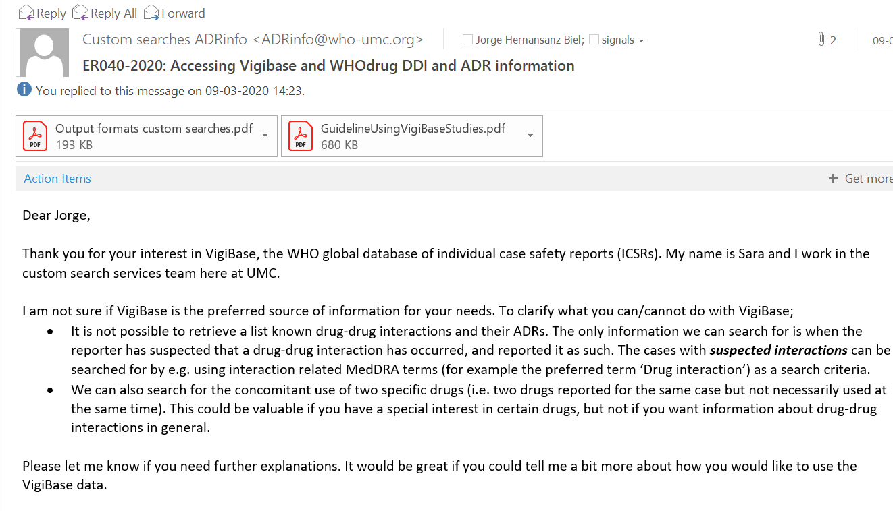
VIGIBASE

